Slide 1

Data-Driven Neural Network Modeling of Nonlinear Fluid Dynamic Systems
Supervisor: Prof. Ashoke De Department of Aerospace Engineering, IIT Kanpur
Team Members: Aman Kashyap, Atharv Soni, Aditya Yadav, Prabal Pratap Singh

Slide 2
Table of Contents
Problem Statement 3
Motivation 4
Introduction 5
Airfoil Selection 9
High-Fidelity Data Generation 13
Data Preprocessing 15
Surrogate Model & PINNs 16
Neural Network Architecture 18
Training & Setup 20
Results & Observations 21
Computational Speedup 23
Learnings 28
Future Work 29
Q&A 30
References 31
Team Contributions 32

Slide 3
Problem Statement
Aerodynamic analysis is critical in fluid dynamics research, especially for aerospace applications. However, traditional Computational Fluid Dynamics (CFD) methods, like Navier-Stokes solvers, are computationally intensive and time-consuming.
This limits scalability for real-time simulations, iterative design processes, and large-scale optimization.
To address this bottleneck, we aim to develop a neural network-based surrogate model that:
Accurately captures nonlinear and transient aerodynamic behavior
Achieves CFD-level accuracy
Requires significantly less computational time and resources
By training on data from high-fidelity Navier-Stokes simulations, the model learns to emulate complex flow dynamics—enabling fast, reliable predictions without re-running expensive CFD simulations.

Slide 4
Motivation
Real-time analysis for autonomous systems, UAVs, optimization loops.
Limitations of existing CFD solvers (XFOIL, FLOW-Unsteady) in speed.
Recent advances in ML enable physics-consistent fast approximations.
PINNs offer a bridge between purely data-driven models and physically accurate simulations.

Slide 5
Introduction
Aerodynamic analysis traditionally relies on CFD simulations.
High-fidelity methods are computationally intensive and time-consuming.
The need: fast, accurate, and physically consistent surrogate models.
Our approach: Physics-Informed Neural Networks (PINNs) for surrogate aerodynamic prediction.

Slide 6
What is CFD?
Computational Fluid Dynamics (CFD) is the use of numerical methods to solve fluid flow equations — primarily the Navier-Stokes equations.
CFD enables simulation of airflows over wings, cars, turbines, etc.
Requires:
Discretization of the flow domain (meshing).
Solving large systems of nonlinear PDEs iteratively.
Tools used in this project:
XFOIL – lightweight 2D panel method, fast but limited near stall.
FLOW-Unsteady – high-fidelity Navier-Stokes solver with turbulence modeling.
While accurate, CFD simulations are time-consuming — especially for unsteady or 3D problems.

Slide 7
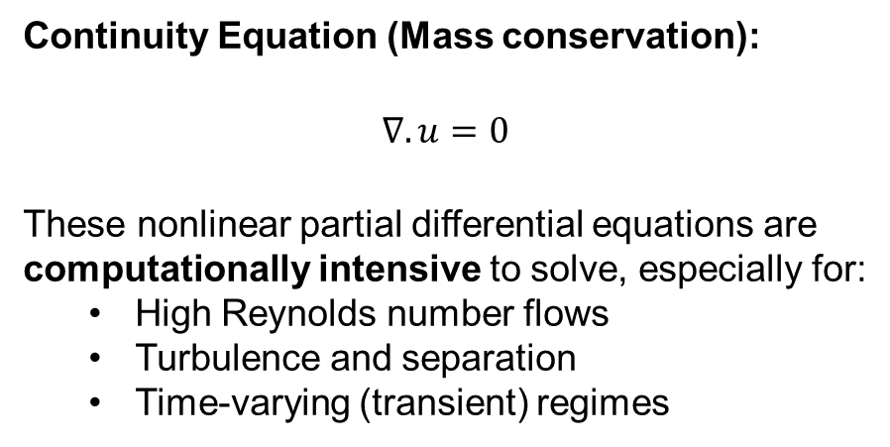
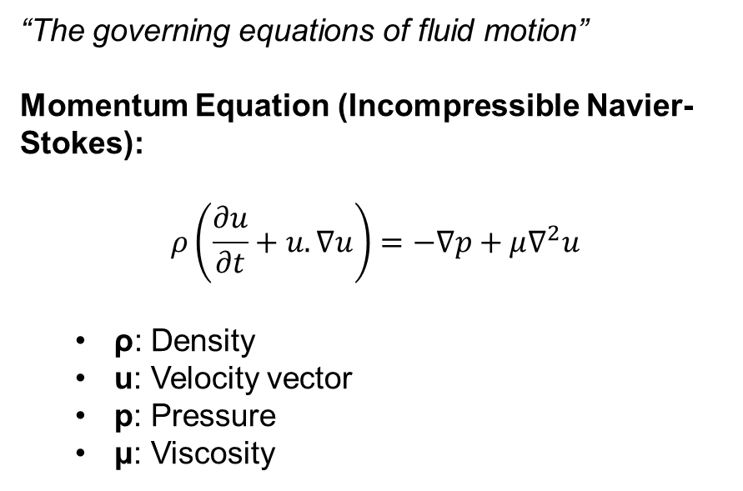
The Navier-Stokes Equations
“The governing equations of fluid motion”
Momentum Equation (Incompressible Navier-Stokes):
$$ρ\left(\frac{∂u}{∂t}+u.∇u\right)=−∇p+μ∇^{2}u$$
ρ: Density
u: Velocity vector
p: Pressure
μ: Viscosity
Continuity Equation (Mass conservation):
$$∇.u=0$$
These nonlinear partial differential equations are computationally intensive to solve, especially for:
High Reynolds number flows
Turbulence and separation
Time-varying (transient) regimes

Slide 8
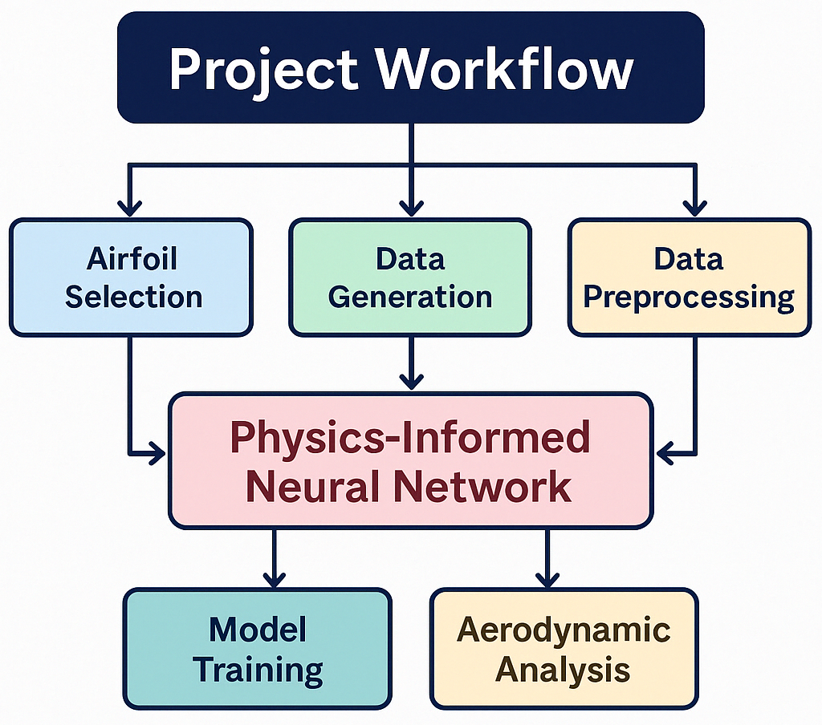
8

Slide 9
Airfoil Selection
~100 airfoils selected through web-based aerodynamic databases, research literature, and curated lists to ensure geometric and performance diversity.
NACA series (e.g., 0012)
Modern laminar flow profiles.
Covered diverse aerodynamic behavior across:
Cambered/symmetric
Low/high Re
Thin/thick profiles.

Slide 10
Airfoil Characteristics and Diversity
10
Diversity in dataset ensures generalization of the neural network.
Key aspects:
Lift and drag behavior variation.
Stall characteristics captured.
Variety in thickness-to-chord ratios.
Broader feature space => Better ML model performance.

Slide 11
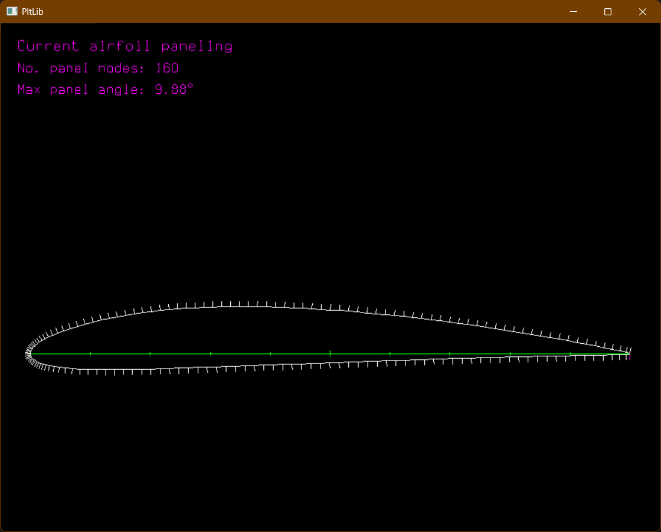
Baseline Simulations using XFOIL
Simulations at Reynolds numbers: 3317, 13131, 22978, 28404, 41039, 44913.
Angles of Attack: −20° to +20°.
Output:
Cl (Lift coefficient)
Cd (Drag coefficient)
Cm (Moment coefficient)
Used for both training and benchmarking.
Figure 1: Paneling of the NACA 3410 airfoil in XFOIL showing 160 panel nodes with a max panel angle of 9.88°. Accurate paneling is crucial for resolving surface pressure distribution.

Slide 12
Why XFOIL?
Fast and lightweight CFD solver.
Suitable for bulk data generation.
Limitations acknowledged:
Struggles with strong separation, high turbulence.
Balanced by high-fidelity FLOW-Unsteady simulations.

Slide 13
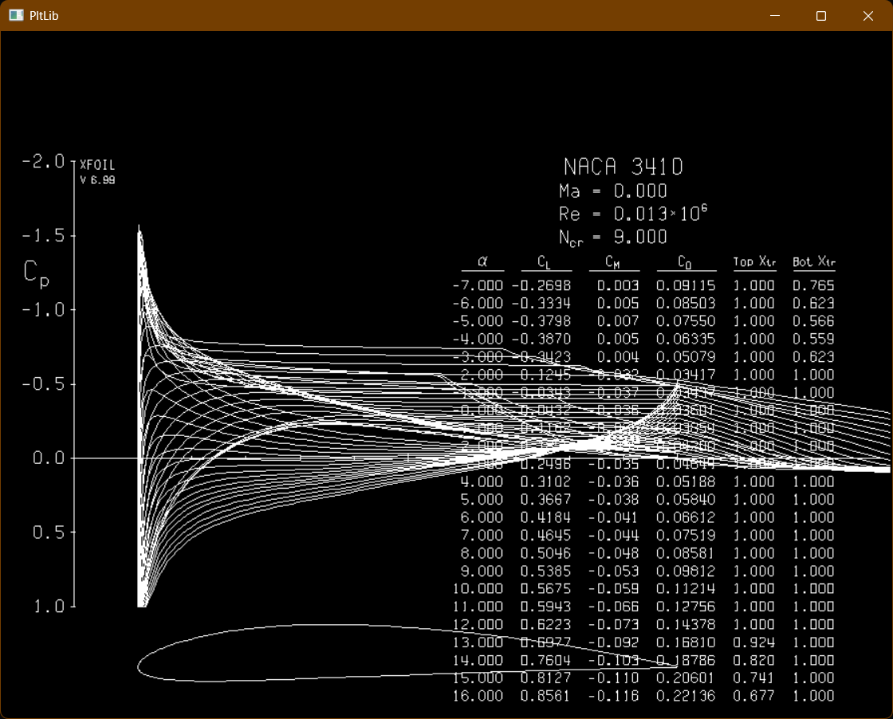
High-Fidelity Data Generation
Used FLOW-Unsteady solver from BYU labs.
Simulated:
Velocity fields
Pressure fields
Vorticity structures
Provided physically accurate training data.
Figure 2: Pressure coefficient distribution and aerodynamic polar output for NACA 3410 at various angles of attack, computed using XFOIL at Re = 0.013 × 10⁶.

Slide 14
alpha | C_{L} | C_{D} | C_{Dp} | C_{M} | Top_{Xtr} | Bot_{Xtr}
-14.00000 | -0.37440 | 0.16238 | 0.14894 | 0.01280 | 1.00000 | 0.68540
-13.00000 | -0.33360 | 0.14875 | 0.13521 | 0.01010 | 1.00000 | 0.78890
-12.00000 | -0.37100 | 0.13379 | 0.11839 | 0.01150 | 1.00000 | 1.00000
-11.00000 | -0.33370 | 0.12041 | 0.10496 | 0.00600 | 1.00000 | 1.00000
-10.00000 | -0.29710 | 0.10725 | 0.09176 | 0.00080 | 1.00000 | 1.00000
-9.00000 | -0.26100 | 0.09443 | 0.07884 | -0.00430 | 1.00000 | 1.00000
-8.00000 | -0.29370 | 0.09070 | 0.07545 | 0.00680 | 1.00000 | 0.93070
-7.00000 | -0.41300 | 0.09283 | 0.07857 | 0.01680 | 1.00000 | 0.64290
-6.00000 | -0.44450 | 0.08203 | 0.06841 | 0.01230 | 1.00000 | 0.55250
-5.00000 | -0.44890 | 0.06833 | 0.05509 | 0.00630 | 1.00000 | 0.52880
Sample XFOIL Data (Re = 13131)
The following table presents a subset of the aerodynamic data generated using XFOIL for the NACA 2508 airfoil at a Reynolds number of 13,131. Each row corresponds to a different angle of attack (AoA), and includes coefficients for lift (C_{l}), drag (C_{d}), pressure drag (C_{dp}), and moment (C_{m}), along with transition locations (Top_{Xtr} and Bot_{Xtr}).

Slide 15
Data Preprocessing
Normalization:
Min-max scaling of inputs (Re, AoA, spatial coords).
Feature engineering:
Added Cp (pressure coefficient) as a derived parameter.
Outlier removal:
IQR filtering to clean anomalies.
Final structured dataset prepared for neural network ingestion.

Slide 16
What is a Surrogate Model?
Fast approximation of a computationally expensive simulator.
Learns to emulate input-output behavior.
In our case: PINN predicts Cl, Cd, Cm based on Re, AoA, geometry.
Key advantage: Speed without losing physics.

Slide 17
Why We Need Surrogate Models
Solving Navier-Stokes equations via CFD is:
Accurate, but
Slow and computationally expensive
Example: A full CFD run may take hours per case, making design sweeps and real-time applications infeasible.
Surrogate Model Solution:
Learn the aerodynamic behavior from CFD data.
Retain physical accuracy by embedding physics into the neural network (PINN).
Predict Cl, Cd, Cm in milliseconds — enabling rapid analysis, control systems, and optimization.
Our goal: "Match CFD accuracy while reducing computation time by 100x–300x."

Slide 18
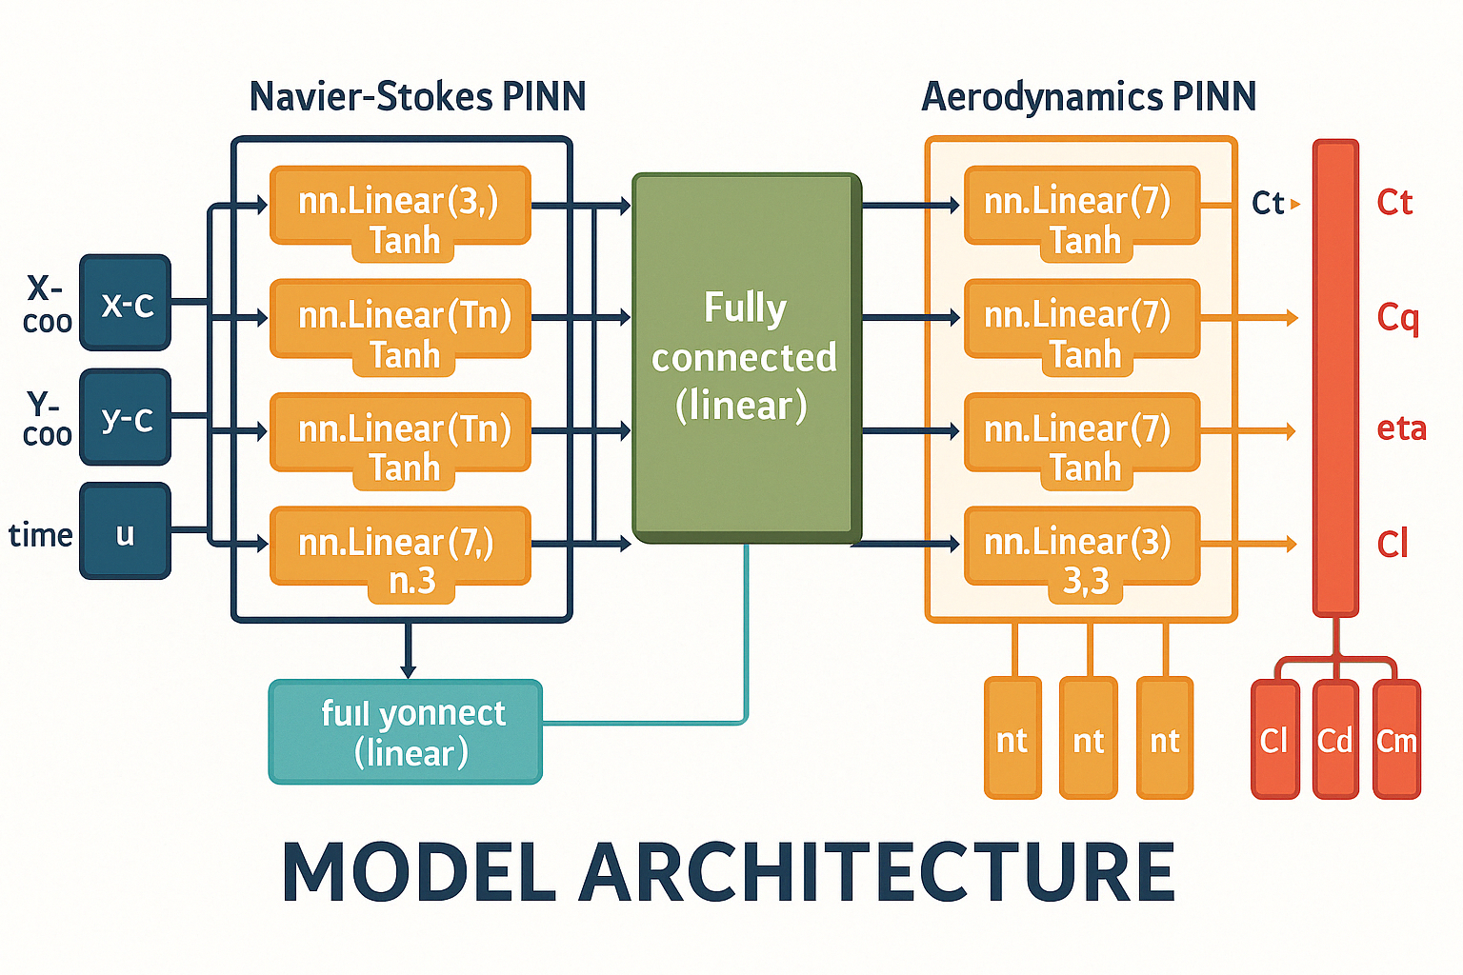
Neural Network Architecture
Two-stage architecture:
NavierStokesPINN: Predicts flow field (u, v, p).
AerodynamicsPINN: Predicts aerodynamic coefficients.
Physics-informed loss:
Combines MSE loss + Navier-Stokes residuals.
Activation: Tanh; Optimizer: Adam; Regularization: Dropout 0.2.
Figure 3: Model Architecture of the Dual-Stage Physics-Informed Neural Network (PINN)

Slide 19
Loss Function Design
Total Loss = Data Loss + λ × Physics Residual Loss.
Ensures:
Data-driven learning
Respect for conservation laws.
Reduces unphysical predictions outside the training range.

Slide 20
Training Setup
Learning rate: 0.001 with decay.
Batch size: 256.
500 epochs with early stopping.
Computation done on Param Sanganak (NSM Facility).
Used 3×48 core nodes for efficient parallelization.

Slide 21
Results – Steady-State Accuracy
Cl prediction:
MAE: 5.2%
R²: 0.91
Cd prediction:
MAE: 7.8%
R²: 0.87
Good agreement with XFOIL results at positive AoA.
Aerodynamic Coefficient | Mean Absolute Error (MAE) | R² Score
Lift Coefficient (C_{l}) | 5.2% | 0.91
Drag Coefficient (C_{d}) | 7.8% | 0.87

Slide 22
Results – Transient Regime Challenges
In stall and separation zones (AoA < 0°):
MAE increased to 15–20%.
Complex flow physics harder for the PINN to capture.
Future directions: LSTM-based temporal modeling.

Slide 23
Computational Speedup
Simulation Tool | Avg. Time per Case | Total Time (15k Cases) | Hardware | Speedup
XFOIL | 4 minutes | ~1000 hours | Single Core | 1×
PINN | 0.8 seconds | ~3.3 hours | 3×48 Core HPC | 300×
Surrogate drastically reduces analysis time — makes real-time feasible.

Slide 24
Visual Comparisons
Plots:
True vs Predicted Cl, Cd
True vs Predicted η
True vs Predicted Cq
Steady-state regions: Good match
Stall regions: Deviations exist but trends captured
PINN demonstrates potential with minor refinements.

Slide 25
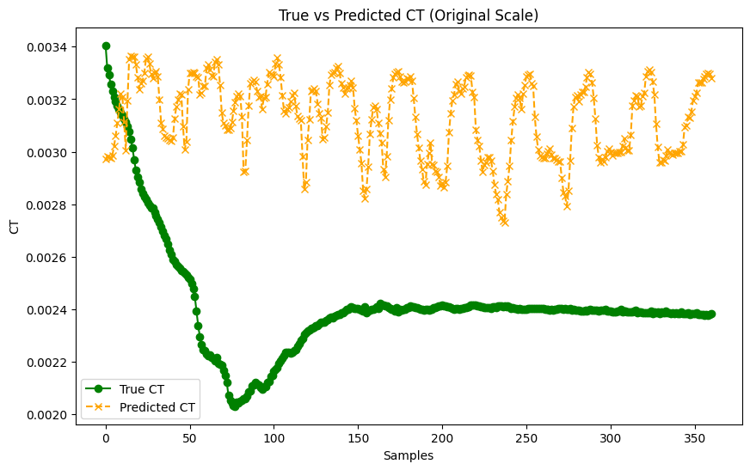
25
Key Observations:
Initial Gap: Predicted CT values differ notably from true values early on, revealing model limitations.
Refinement Path: Errors guided improvements like data augmentation and retraining.
Progress Baseline: Plot acts as a benchmark to evaluate future optimizations.
Clear Visualization: Original-scale comparison highlights model shortcomings and areas for tuning.

Slide 26
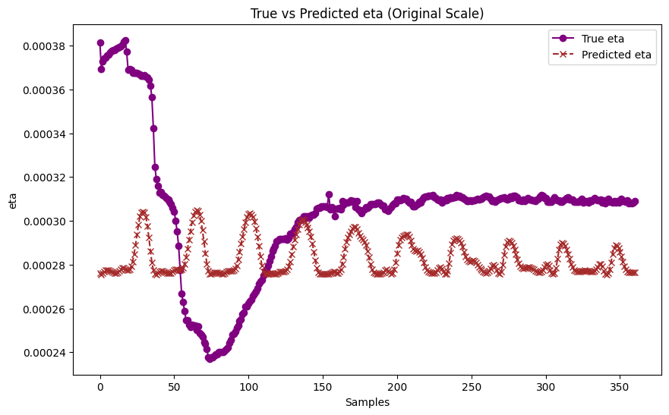
26
Key Observations (η Plot):
Initial Dip in True η: A steep decline followed by recovery reflects transient aerodynamic effects before stabilization.
Prediction Oscillations: Predicted η remains stable but oscillatory, indicating limited capture of early transients.
Better Steady-State Match: Model performance improves significantly in later samples, aligning well under steady conditions.

Slide 27
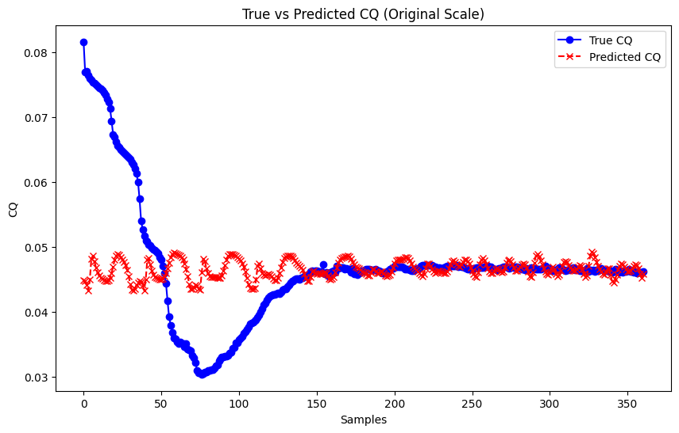
27
Key Observations (Cq):
Transient Phase: True Cq values show sharp variation early on, reflecting transient flow dynamics.
Model Bias: Predicted Cq remains smoother but oscillates, revealing limited capture of early non-linear effects.
Steady-State Accuracy: Alignment improves over time, indicating better model reliability in later, stable regimes.

Slide 28
Learnings and Key Takeaways
ML models can emulate aerodynamic behavior with high speed and reasonable accuracy.
Embedding physics dramatically improves generalization.
Dataset diversity is critical.
Flow separation remains a challenge without temporal memory (LSTM, RNN).

Slide 29
Future Work
Extend model to 3D wings and full aircraft sections.
Incorporate experimental datasets for validation.
Develop uncertainty quantification around predictions.
Explore hybrid ML-CFD pipelines for complex flow regimes.

Slide 30
Thank You
We thank the National Supercomputing Mission for HPC access and Prof. Ashoke De for his valuable mentorship.
We welcome any questions from the panel.

Slide 31
Team Contributions
Aman Kashyap
Airfoil Selection & Baseline Simulation (XFOIL) Generated baseline aerodynamic data for 100+ airfoils using XFOIL and supported neural network training on Param Sanganak.
Aditya Yadav
Data Preprocessing & Feature Engineering
Normalized and structured the simulation data, filtered outliers, and derived essential flow parameters for neural network input.
Prabal Pratap Singh
Neural Network Design, Training & Validation
Developed and trained a two-stage PINN architecture, handled performance benchmarking, and integrated physics-informed loss design.
Atharv Soni
High-Fidelity Data Generation (FLOW-Unsteady)
Performed advanced CFD simulations using FLOW-Unsteady with turbulence modeling to generate physically rich data for ML training.

Slide 32
References
Alvarez, E. J., Mehr, J., & Ning, A. (2022). FLOWUnsteady: An Interactional Aerodynamics Solver for Multirotor Aircraft and Wind Energy. AIAA Aviation Forum, Chicago, IL, June 2022.
Raissi, M., Perdikaris, P., & Karniadakis, G. E. (2019). Physics-Informed Neural Networks: A Deep Learning Framework for Solving Forward and Inverse Problems Involving Nonlinear Partial Differential Equations. Journal of Computational Physics, 378, 686–707.
Zhang, D., Lu, L., Guo, L., & Karniadakis, G. E. (2019). Quantifying Total Uncertainty in Physics-Informed Neural Networks for Solving Forward and Inverse Stochastic Problems. Journal of Computational Physics, 397, 108850.
Chakraborty, S., & Karniadakis, G. E. (2021). Transfer Learning Based Multi-Fidelity Physics-Informed Deep Neural Network. Journal of Computational Physics, 426, 109942.
Liu, X., Zhang, X., Peng, W., Zhou, W., & Yao, W. (2022). A Novel Meta-Learning Initialization Method for Physics-Informed Neural Networks. Neural Computing and Applications, 34(17), 14511–14534.

